Slide 1
COMPETENCY PROFILE

Slide 2
CONTENTS
The Company
Our Approach to IFM
EGC Facility Management Pvt. Ltd. Service Bouquet
Quality Plan
Critical Differentiator - Costing
EGC Facility Management Pvt. Ltd. Advantage
Why Choose us?
Client List
Contact us

Slide 3
THE COMPANY
With a Mission to become the leading Property Management organization in India by 2020.
Built on:
Ethical practices
Corporate discipline
Strong knowledge-base
Launched in the year 1997
Already has over 3.0 million square feet under management
Managing premium organizations in Kolkata’ and other part of the Country
An ISO 9001:2008 &18001:2007 accredited company
Affiliated to:
Directorate of M&SSE (Govt. of West Bengal). Regn. No. UDYAM-WB-10-0000551

Slide 4
OUR APPROACH TO IFM
Facilities Management's effectiveness is measured through ..... helping clients attract and retain good employees by providing an excellent working environment
ORGANIZATION
NEEDS
FM is all about managing people and places to achieve best value for money by balancing between user needs and business needs to achieve optimum organizational effectiveness
OCCUPANTS
PERCEPTIONS
PRODUCTIVITY
WORKING
ENVIRONMENT
Infrastructure
Micro-environment
Facility Services
COST

Slide 5
EGC Facility management pvt. Ltd. Service Bouquet
We help you mind your ‘Core’ business, we will do the rest…
That’s our business!

Slide 6
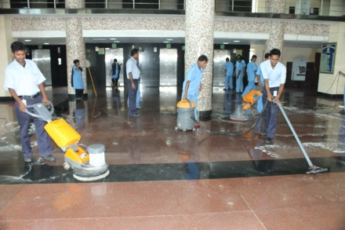
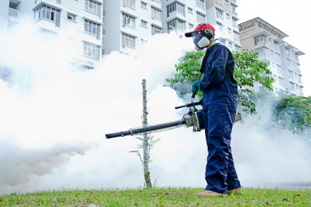
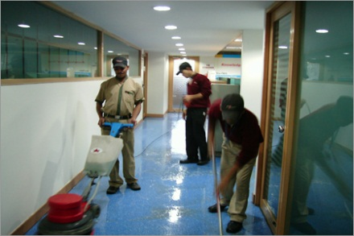
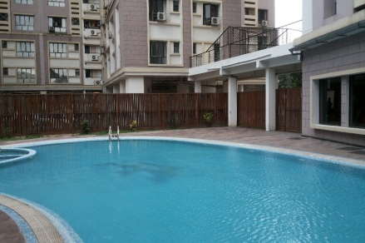
EGC Facility management pvt. Ltd. Service Bouquet
Property & Asset Management
Electrical, Plumbing, and Civil maintenance
Management Services
Safety Audit, Statutory Compliance, Local Authority Liaisoning Renewals & Returns
Facility Management Consultancy
Resource Planning , Vendor Selection, CAM estimation, AMC evaluation. Certification Support
Environmental & Housekeeping Services
Housekeeping & Floor care, Mechanized Special Cleaning, Façade Cleaning
Horticulture & Pest Control Services
State of the art maintenance of gardening and Horticulture and Pest Control Services
Energy Management
Monitoring current trends and consumption levels
Project reductions through integrated approach
Office Support Services
Pantry management, Helpdesk, Front Office , Mailroom, Travel Desk, Reprographics and Stationery
Fire & Health & Safety Management
Vendor Selection

Slide 7
Suggested - Quality Plan
We base our quality control on a TOTAL QUALITY PLAN, which takes into account not only the measured quality, but also the PERCEIVED QUALITY
Quality Delivered
Quality Norms
By Client
Perceived Quality
By the Users
Wanted Quality
Quality Norms Defined in Our Procedures
Our site staff work with key performance indicators, defined with the Client for each service, while regularly measuring perceived quality by the way of satisfaction surveys

Slide 8
Relationship Evolution and Market Evolution
Strategic Alliance
mutual dependency
best in class services & product
high level of commitment
strategic framework in place
extended capabilities and capacity
significantly enhanced shareholder value
Alliance
long term open relationship
high degree of trust
mutual advantage
focus on significant added value
senior management interaction
From a Supplier to Business Partner
Preferred Supplier
longer term relationship
mutual trust
differentiation of product & service
focus on added value
price to quality comparison
Service Vendor
generic product & services
minimum contract life
contract driven
lowest price focus

Slide 9
Critical Differentiator - Costing
Performance Based
Fixed Fee
Performance
Incentive Fee
DIRECT COST
Combination of a fair fixed fee and a performance fee, representing profit to drive excellence and process improvement.

Slide 10
The EGC Facility Management Pvt. Ltd. Advantage
Global value at local price
Increase productivity
Effectively manage cost
Wider range of skills can be accessed
Access to industry best practice
Single point of responsibility
Continuous improvement through measurement focus
Flexibility
Reduced administration
Workplace and facilities services fit for business needs ...
Cost
Quality

Slide 11
Why Choose us?
‘I want a property management company that helps me increase the value of my property’
We bring our experience to work collaboratively with customers to deliver the support they need for the future
Furthermore, we are fully legally compliant pertaining to all statutory norms
We are excited about the future and passionate about helping you achieve your strategic goals and importantly reduce costs
Lastly, we focus on building relationships with you to ensure you've got the right support to be ready for the future

Slide 14
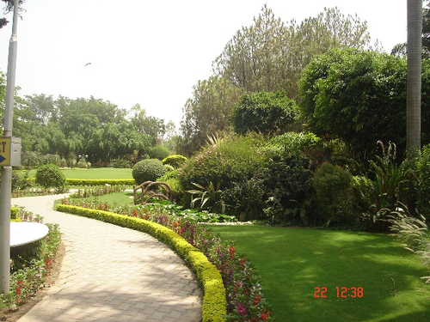
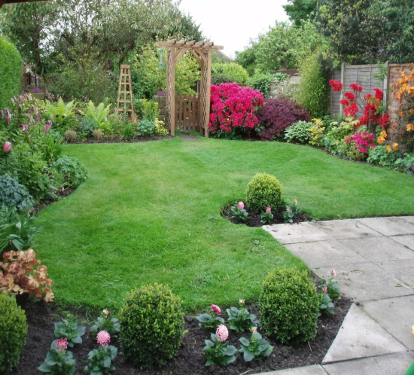

Slide 15
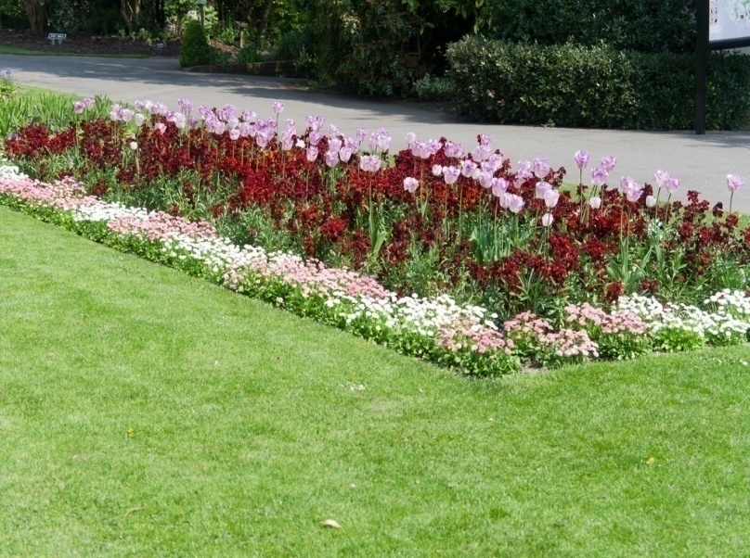

Slide 16
We won’t just manage your property;
we’ll add value to it.

Slide 17
Partial Client List - Govt. Organizations
Reserve Bank of India (Bhopal)
Office of the Chief Commissioner of Income Tax (GOI)
Central Excise Kolkata – I Commissionerate (GOI)
Office of the Commissioner of Customs (GOI)
Ministry of Statistics & Programme Implementation (GOI)
Ministry of Textiles (GOI)
Indian Audit Department
National Sample Survey (MoS P.I.) (GOI)
Central Institute of Freshwater Aquaculture
National Bank for Agriculture & Rural Development (NABARD) (Kolkata & Bhubanewsar)
West Bengal Board of Higher Secondary Education (WB)
State Bank of India – All India
Bank of Baroda (U.P.)
Balmer Lawrie & Co. Ltd.
BENFED
West Bengal Small Scale Industries Development Corporation Limited
Union Bank of India – Training Centre, Lucknow, U.P.
Direct Taxes Regional Training Instutute, Kolkata, Central Govt.
National Jute Board
Income Tax Poorva (kolkata) Gardening Services
Allahabad Bank, Training Centre, Kolkata
ESI Hospital, Uluberia, W.B.
West Bengal State Police Housing Corporation Ltd (Araksha Bhawan)
North Eastern Electric Power Corporation Ltd (NEEPCO)
Victoria Memorial
Central Glass Ceramic Research Institute
Bhawani Bhawan, Kolkata
Science City, Kolkata
LIC, Kolkata

Slide 18
Partial Client List - Pvt. Organizations
Ruby General Hospital, Kolkata
RSV Hospital, Kolkata
Royd Nursing Home, Kolkata
Ashok Nursing Home & Health Care Pvt.Ltd.
B.P.Poddar Hospital
Bellona Nursing Home & Diagnostic Center
NIFT Gardening Services ( Kolkata)
Dreamland Nursing Home, Kolkata
Apex Institute of Medical Science, Kolkata
Sparsh Diagnostic Centre, Kolkata
Tata Avenida (Kolkata) Gardening Services.
Bengal NRI Complex(Urban), Kolkata
Unnayan Commercial Complex
South City Belair Property Management Pvt.Ltd.
BMRC Hospital, Barrack pore
Union Bank (Lucknow) Gardening Services.
Abhishek Entertainment & Foods Pvt. Ltd., Kolkata
Subham Banquet
Hiland Green, Kolkata
Kasba New Market, Kolkata
B. P. Poddar Institute of Technology, Kolkata
Arcade Mall, Burdwan, W.B.
Elixir Complex, Kolkata
Bata India Limited. Kolkata
Maruti One Auto
Tirumani Owners Association
Tata Ariana ( Bhubaneswar ) Gardening Services
Orbit Heights Owners Association
Rene (Retail Shop)
Shree Jain Hospital (Howrah Shibpur)
Merlin Riverside
AND MORE…………..

Slide 19
Contact us
Regd. Office
6A, Rajani Bhattacharjee Lane
Kolkata – 700 026
Tele # 033-2463 4889 / 9339435196
Email # egc.ratanbiswas@gmail.com
Email # egcgroup.rb@gmail.com
Web # WWW.egcgroup.in
Branch Office:
1582, Rajdanga Main Road, 2nd Floor, Room No. 202, Kolkata- 700107
B-405, Laxmi Krupa, CHS Ltd.
Near Sai Temple, S. V. Road
Bhayander (East)
Mumbai – 401 105 (Maharashtra)

Slide 20
We look forward to doing business with you!
Thanking You
Egc facility management pvt. Ltd.

